Slide 1

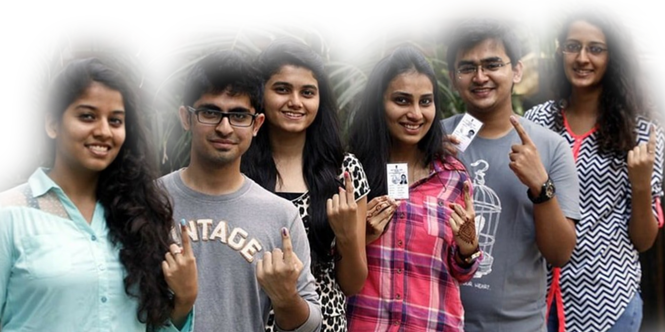
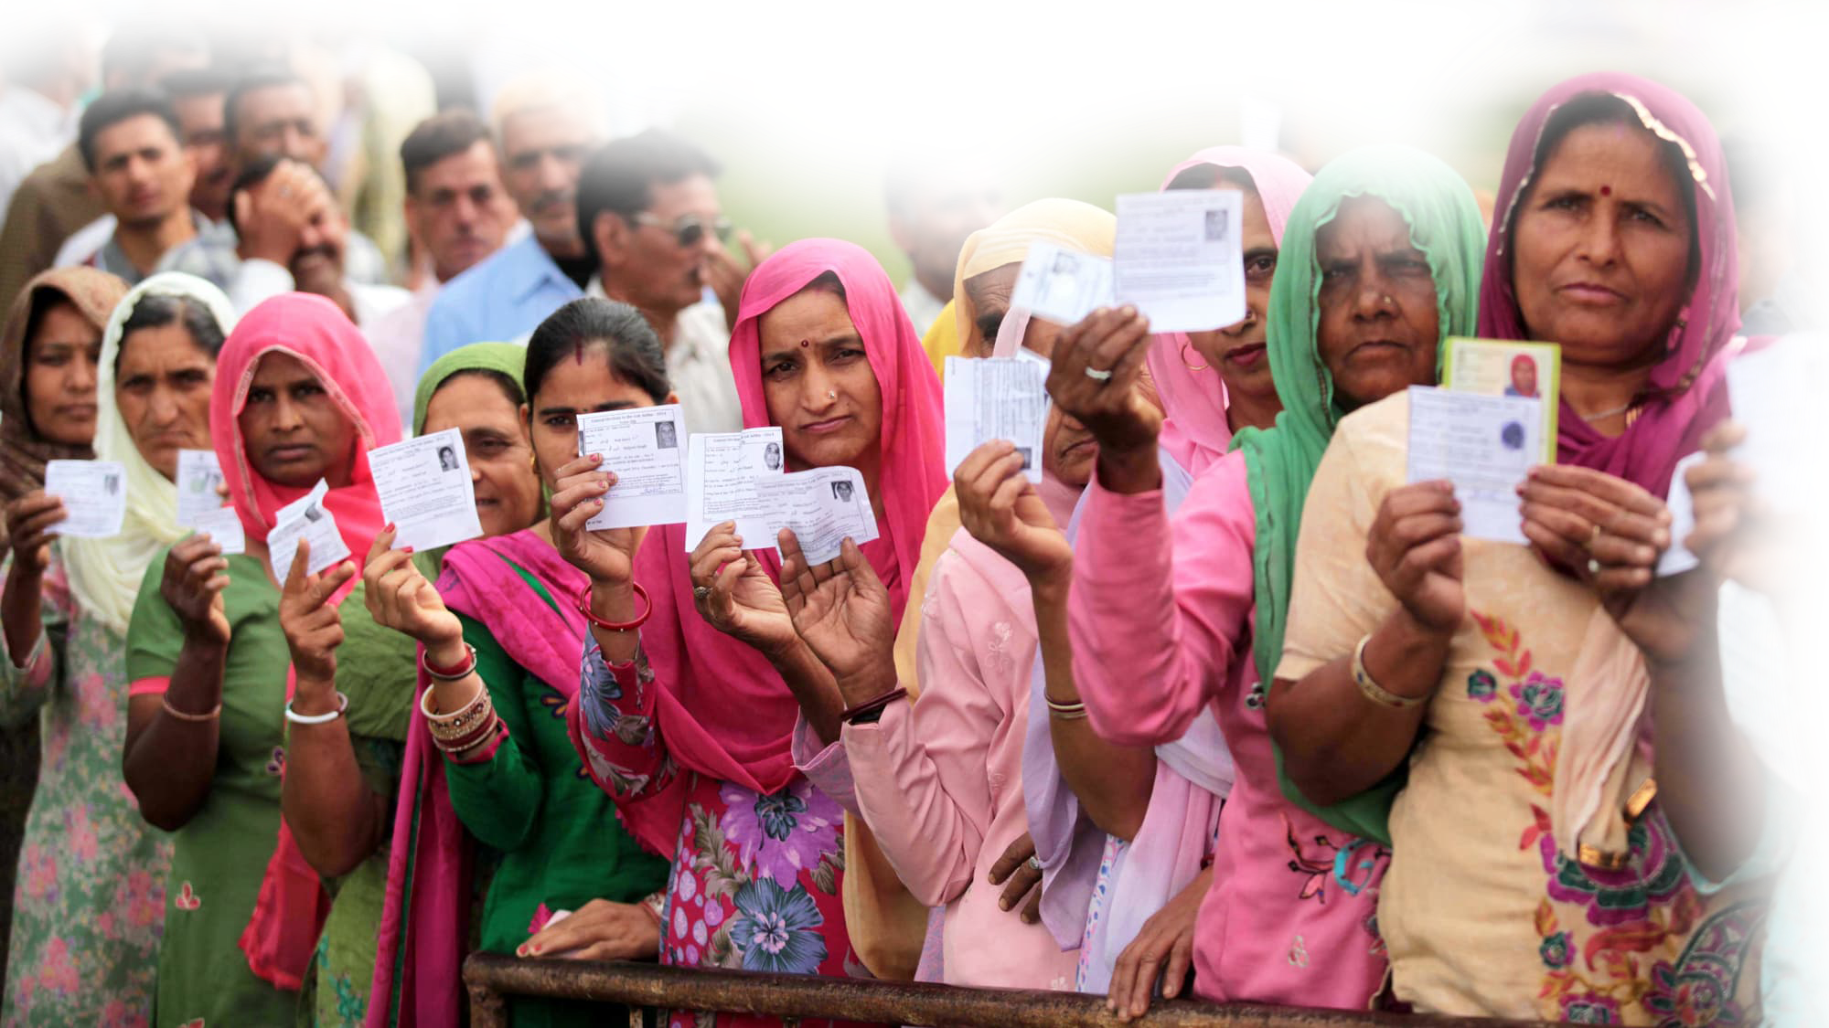
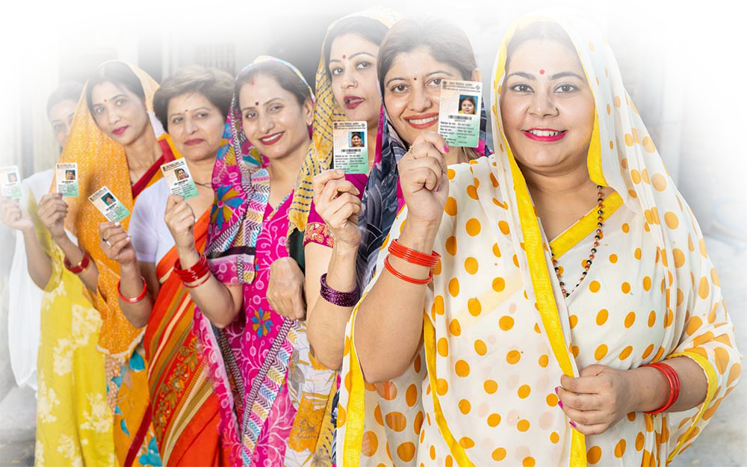
Pure Electoral Rolls Strengthen Democracy
SPECIAL INTENSIVE REVISION
Phase I – Successfully completed in Bihar with Zero Appeals
Phase II – To start in 12 States/UTs

Slide 2
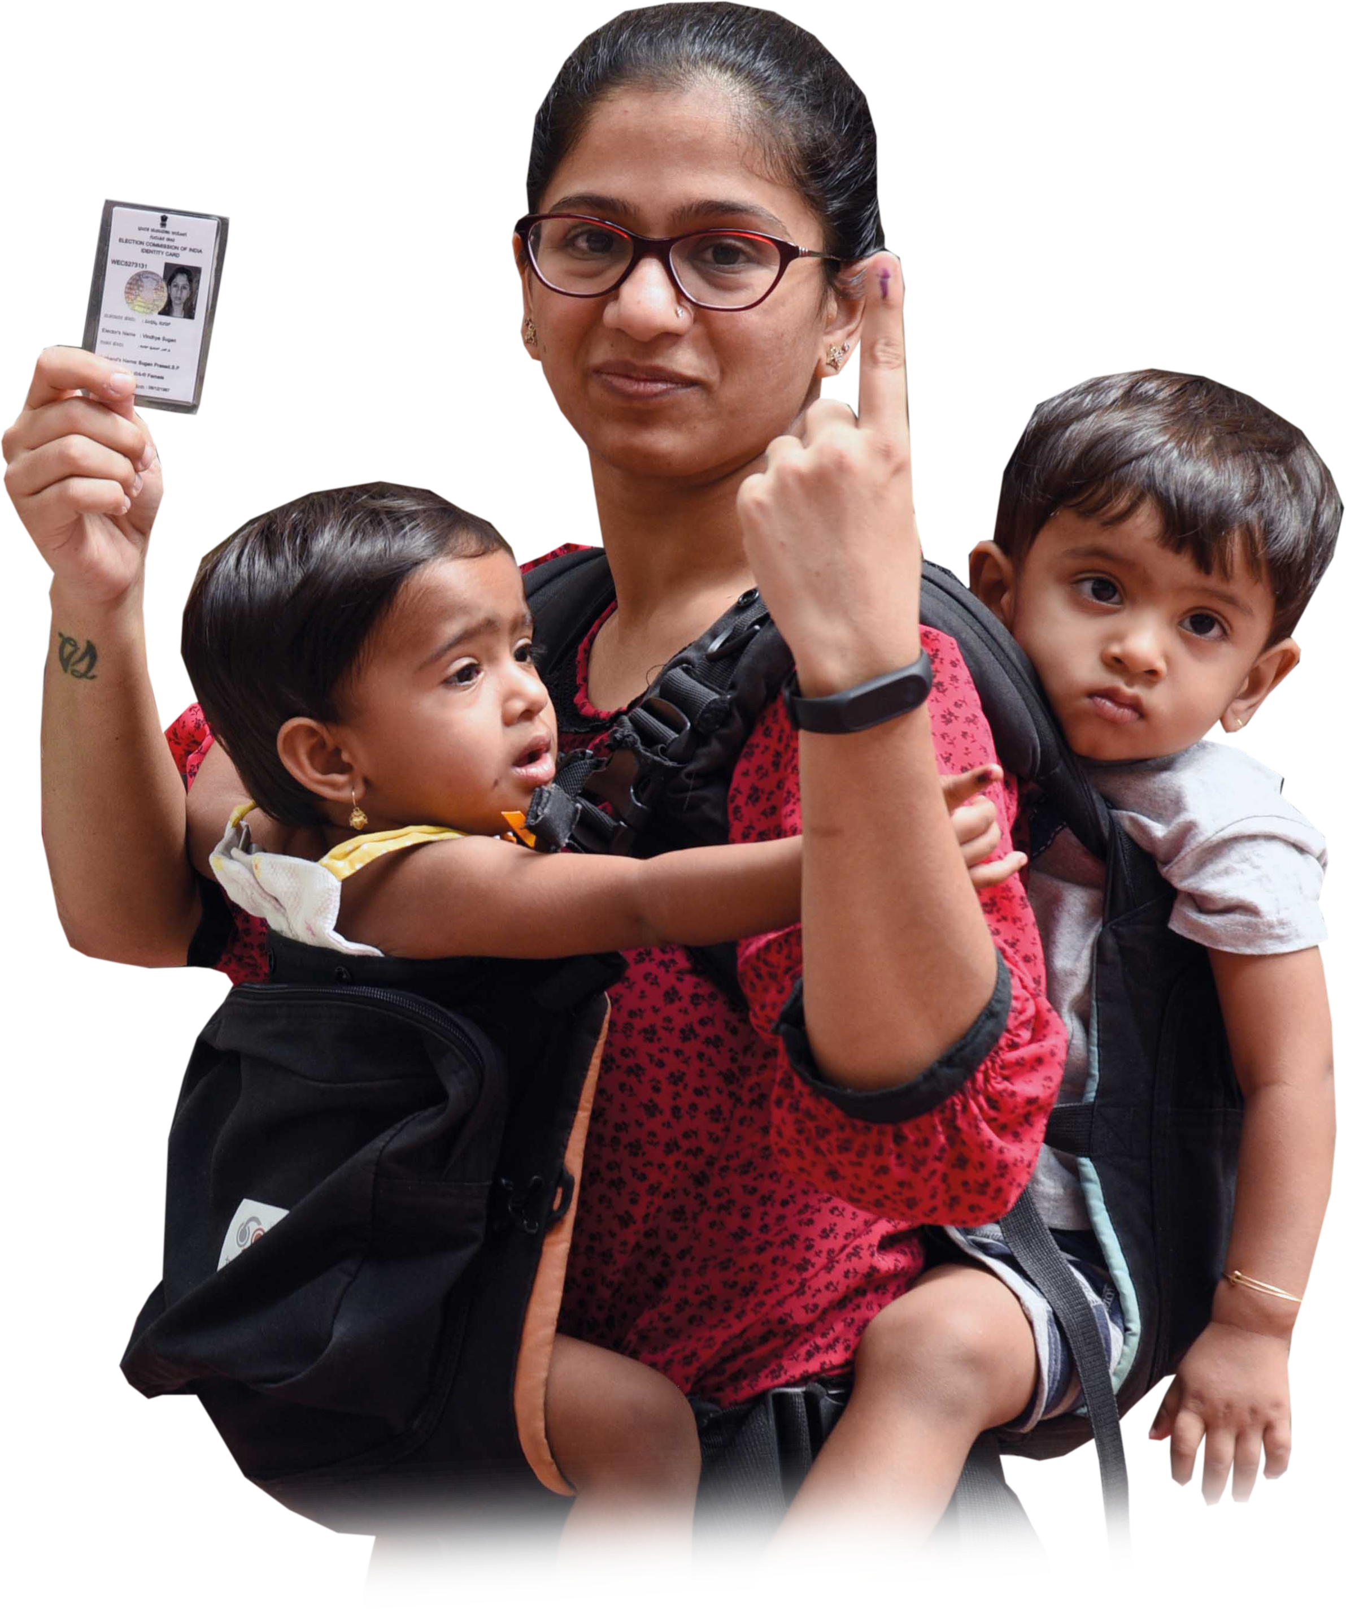
Eligibility for Elector
Article 326 of the Constitution of India
Citizen of India
At least 18 years of age
Ordinarily Resident of the Constituency
Not disqualified under any Law

Slide 3
Need for SIR
As per Law, Electoral Rolls have to be revised :
  before every election; or
  as per requirement
Political parties have been raising issues relating to quality of Rolls
SIR has already been done 8 times from 1951 till 2004
Last SIR was done more than 21 years back in 2002-2004
Many changes in electoral rolls have occurred due to:
    Frequent migration
    Resulting in voters getting registered at more than one place
    Non-Removal of Dead Voters
    Wrongful inclusion of any Foreigner
3

Slide 4
Key Functionaries of SIR
There are around 1,000 electors in each Polling Station
There is one Booth Level Officer (BLO) for each Polling Station
Each Assembly Constituency has many Polling Stations
One Electoral Registration Officer (ERO) for each Assembly Constituency
The ERO is a Sub Divisional Magistrate (SDM) level Officer who, as per Law:
  Prepares the Draft Electoral Rolls,
  Receives and Decides on Claims and Objections, and
  Prepares and Publishes the Final Electoral Rolls.
Assistant Electoral Registration Officer(s) (AEROs) for each Tehsil
The District Magistrate hears the 1st Appeal against the decision of ERO
The CEO of the State/UT hears the 2nd Appeal against the decision of DM
4

Slide 5
Key Processes of SIR
EROs/AEROs will:
  Print Unique Enumeration forms (EFs) for each elector as on 27th October, 2025
  EFs will contain necessary details as contained in the current voter list
BLOs will:
  Distribute the EFs to each existing Elector
  Help the Elector in matching/ linking with either their name or their relative’s name
  in last SIR held in 2002-2004
  For Matching/ Linking Electors/ BLOs can also access All-India database (https://voters.eci.gov.in/ ) of previous SIR
5

Slide 6
Key Processes of SIR
BLOs will:
  Collect Form 6 & Declaration form for inclusion of new Elector and help in Matching/Linking
  Help the Elector fill in the EF, collect it and submit it to the ERO/AERO
  Make at least 3 Visits to the house of each Elector
  Electors can also fill the EF Online, particularly urban voters/ temporary migrants.
  Identify dead, permanently shifted and voters who are registered at more than one place
  Except the EF, No other document needs to be collected with EF during Enumeration Phase
6

Slide 7
Key Processes of SIR
EROs/ AEROs will:
  Include in the Draft Rolls, the names of all Electors whose Enumeration Forms are received
  Issue Notice to all those Electors whose names could not be matched/ linked with last SIR
  Hear such cases for eligibility and decide on inclusion or exclusion of their names in Final Rolls
EROs/ AEROs must ensure that:
  No eligible citizen is left out; and
  No ineligible person is included.
District Magistrates (DMs) will hear the 1st Appeal against the decision of ERO
Chief Electoral Officers will hear the 2nd Appeal against the decision of DMs.
7

Slide 8
Key Steps of SIR
Pre-Enumeration Phase
  Training of BLOs, EROs and DEOs
  Manual Matching/ Linking with Last SIR by BLOs
  Computer Matching/ Linking with Last SIR by ECINET
Involvement of Political Parties
  CEOs, DEOs and EROs to meet all Recognised Parties and explain the SIR process in full detail
  Training of Booth Level Agents (BLAs) appointed by all Recognised Political Parties
  BLAs can also collect duly filled in EFs from Electors, certify up to 50 EFs/Day and submit to BLO
Enumeration Phase
  Printing, Distribution, Matching/ Linking and Collection of duly filled in Enumeration Forms
  Rationalisation of Polling Stations with an upper limit of 1,200 voters
8

Slide 9
Key Steps of SIR
Publication of Draft Electoral Rolls
  Draft Rolls will contain all Electors whose Enumeration Form has been received
  List of Absent/Shifted/Death/Duplicate names not included in Draft Roll to be put on CEO website/public offices
Issuance of Notices and taking a Decision thereon by EROs/AEROs
  Notices will be issued for Electors who could not be matched/linked with last SIR
  Verifying indicative documents to ascertain their eligibility as an Elector
  Hearing to ascertain their whereabouts prior to last SIR
Receiving and Deciding on Claims & Objections by EROs/ AEROs
  Any elector or BLA of Recognised Political Parties can file a Claim or Objection
Publication of Final Electoral Rolls
Receiving and Deciding 1st Appeal by DMs and 2nd Appeal by CEOs
9

Slide 10
Key Steps of SIR
Deployment of Volunteers
Deployment of volunteers to take care that :
  Genuine Electors, particularly old, sick, PwD, poor and other vulnerable groups, are not harassed and are facilitated to the extent possible.
Rationalisation of Polling Stations
No Polling Station to have more than 1200 Electors
New polling stations to be made in the High Rise/RWA colonies/slum clusters
DEOs to consult political parties on new polling stations.
Special care to keep all members of one family in one polling station
10

Slide 11
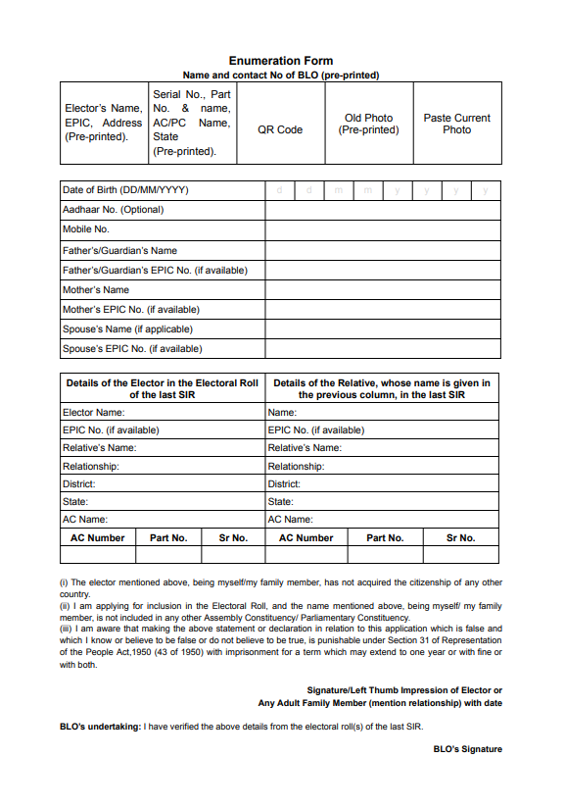
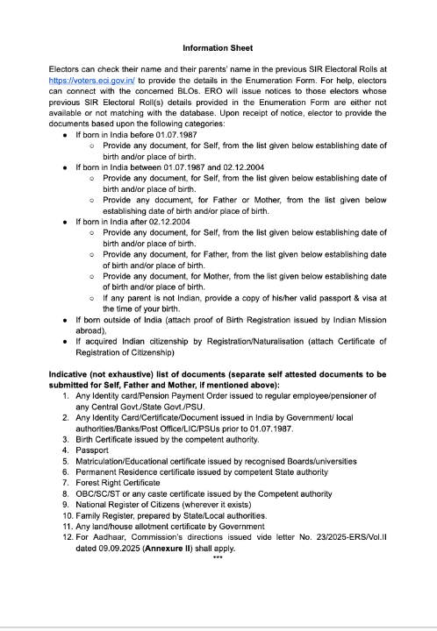
Enumeration Form
Details of
previous SIR
11

Slide 12
Enumeration Form – Partially Pre-Filled
Elector’s Name, EPIC, Address (Pre-printed). | Serial No, Part No. & name, AC/PC Name, State (Pre-printed). | QR Code | Old Photo (Pre-printed) | Paste Current Photo (To be pasted by Electors)
All Electors are requested to paste their recent coloured photographs
12

Slide 13
Enumeration Form – To be Filled by Elector
Date of Birth (DD/MM/YYYY)
AADHAAR No. (Optional)
Mobile No.
Father’s/Guardian Name
Father’s/Guardian EPIC No. (if available)
Mother’s Name
Mother’s EPIC No. (if available)
Spouse’s Name (if applicable)
Spouse’s EPIC No. (if available)
13

Slide 14
Details in Electoral Rolls of Previous SIR : To be Filled by Elector
Details of Elector in Electoral Roll of the last SIR (if applicable) |  |  | Details of the Relative, whose name is given in previous column, in the last SIR
Elector Name: |  |  | Name:
EPIC No. (if available) |  |  | EPIC No. (if available)
Relative’s Name: |  |  | Relative’s Name:
Relationship: |  |  | Relationship:
District : |  |  | District :
State: |  |  | State:
AC Name: |  |  | AC Name:
AC Number | Part No. | Sr No. | AC Number | Part No. | Sr No.
14

Slide 15
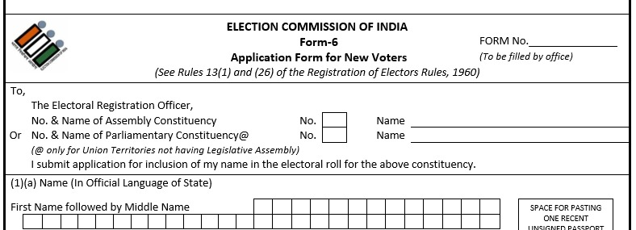
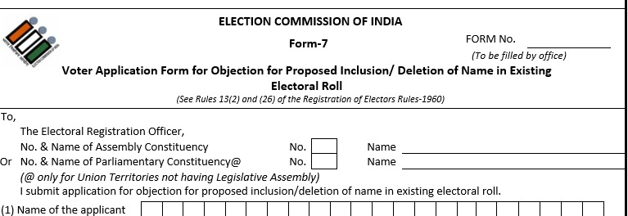
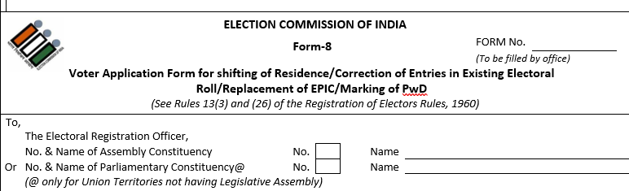
FORM 6
+Declaration Form
For Enrolment
To be filled by New Electors
FORM 8
For Correction/Shifting
To be filled only by Elector
FORM 7
For Deletion
To be filled by an Elector of same AC
15

Slide 16
List of Indicative (not Exhaustive) Documents
Any Identity card/Pension Payment Order issued to regular employee/pensioner of any Central Govt./State Govt./PSU.
Any Identity Card/Certificate/Document issued in India by Government/local authorities/Banks/Post Office/LIC/PSUs prior to 01.07.1987.
Birth Certificate issued by the competent authority.
Passport
Matriculation/Educational certificate issued by recognised Boards/universities
Permanent Residence certificate issued by competent State authority
Forest Right Certificate
OBC/SC/ST or any caste certificate issued by the Competent authority
National Register of Citizens (wherever it exists)
Family Register, prepared by State/Local authorities.
Any land/house allotment certificate by Government
For Aadhaar, Commission’s directions issued vide letter No. 23/2025-ERS/Vol.II dated 09.09.2025 shall apply.
16

Slide 17
 | State/UT | Electors ( in Lakhs) | Polling Stations /BLOs | Political Party BLAs | EROs/AEROs | DEOs
1 | Andaman & Nicobar | 3.10 | 411 | 435 | 11 | 3
2 | Chhattisgarh | 2,12.30 | 24,371 | 38,368 | 467 | 33
3 | Goa | 11.85 | 1,725 | 669 | 80 | 2
4 | Gujarat | 5,08.39 | 50,963 | 28,524 | 1,037 | 33
5 | Kerala | 2,78.50 | 24,468 | 54,624 | 280 | 14
6 | Lakshadweep | 0.58 | 55 | 65 | 11 | 1
7 | Madhya Pradesh | 5,74.05 | 65,014 | 1,19,940 | 762 | 55
8 | Puducherry | 10.21 | 962 | 1,376 | 60 | 2
9 | Rajasthan | 5,48.85 | 52,490 | 97,873 | 933 | 41
10 | Tamil Nadu | 6,41.15 | 68,467 | 2,11,445 | 1,009 | 38
11 | Uttar Pradesh | 15,44.24 | 1,62,486 | 1,92,986 | 2,445 | 75
12 | West Bengal | 7,66.24 | 80,681 | 18,114 | 3,353 | 24
 | Total | 50,99.46 (~51 Crores) | 5,33,093 | 7,64,419 | 10,448 | 321
17

Slide 18
Schedule
Sr. No | Description | Date
1. | Printing/Training | 28th Oct to 3rd Nov 2025
2. | House to House Enumeration Phase | 4th Nov to 4th Dec 2025
3. | Publication of Draft Electoral Rolls | 9th Dec 2025
4. | Claims & Objection Period | 9th Dec 2025 to 8th Jan 2026
5. | Notice Phase (Hearing & Verification ) | 9th Dec 2025 to 31st Jan 2026
6. | Publication of Final Electoral Rolls | 7th Feb 2026
18

Slide 19
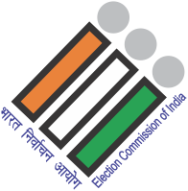

Thank You

